Slide 1
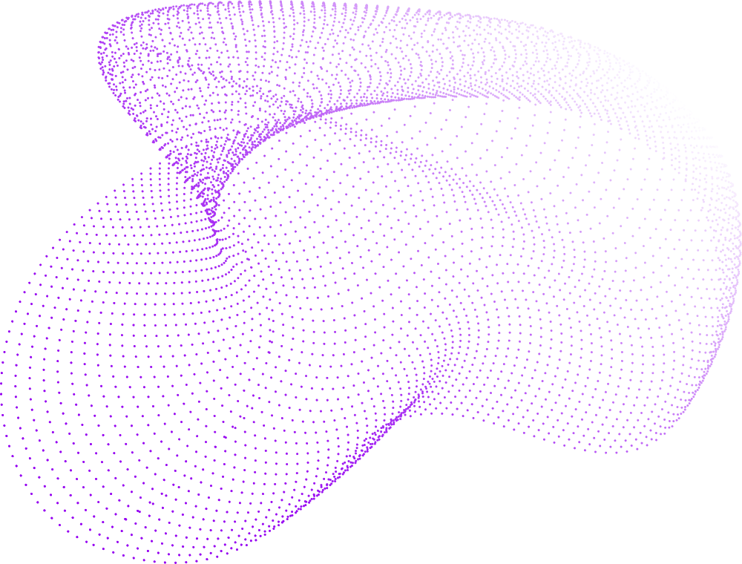
Project Name: Implementation of an Automated solution for the Sound alike component of a Lasa Error for Nursing workstation
Group Members Name:
Sagnik Saha
Bibek Gorai
Shivam Kumar Singh
Avijit Ray

Slide 2
Outline
Problem Statement
Introduction
Why it is required to include in healthcare.
Real world hospital nurse order the medicine to the pharmacy.
Medication Error
Objective & motivation
Existing research work
Technology Consider
Future Work
Conclusion

Slide 3
Problem Statement
Medication errors, especially Look-Alike Sound-Alike (LASA) drugs, are a major cause of preventable harm in hospitals. Nurses often mishear or misread medicine names during prescription, transcription, or administration.
There is no quick tool available at the nursing workstation that can:
Verify if a spoken or handwritten medicine name sounds similar to another drug
Automatically detect high-risk LASA pairs
Assist nurses in making safe medication decisions in real time
This leads to:
Wrong-medicine administration
Delayed treatment
Increased patient risk
High clinical burden on hospital staff

Slide 4
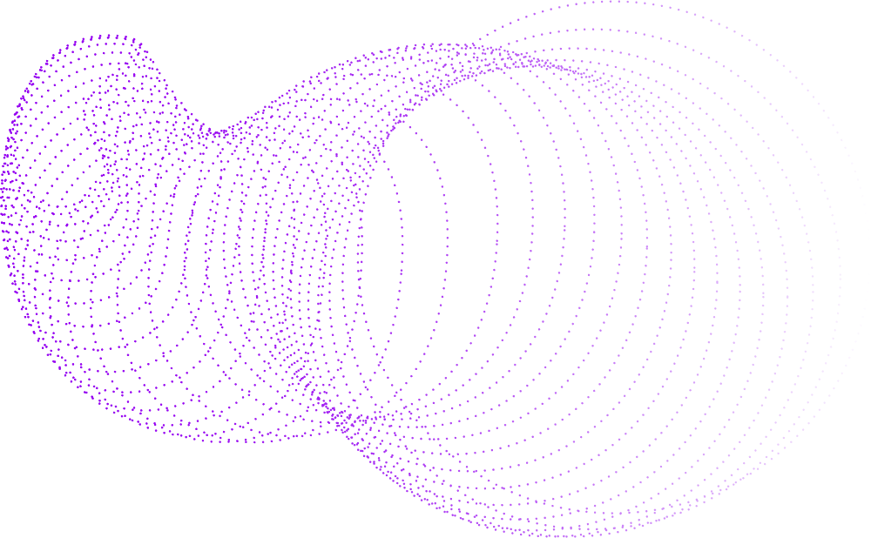
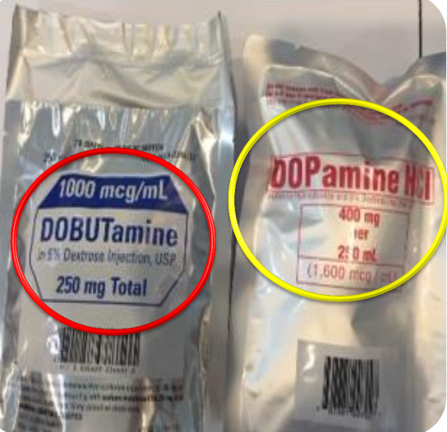
Introduction:
The Look-Alike, Sound-Alike (LASA) problem in the medical field refers to situations where medications have similar names or appearances, leading to confusion and potential errors in prescribing, dispensing, or administering drugs.
LASA Issues:
Similar-sounding drug names – e.g., Hydroxyzine (antihistamine) vs. Hydralazine (blood pressure medication).
Similar-looking packaging – Two different drugs may have similar packaging, making them easy to mix up.

Slide 5
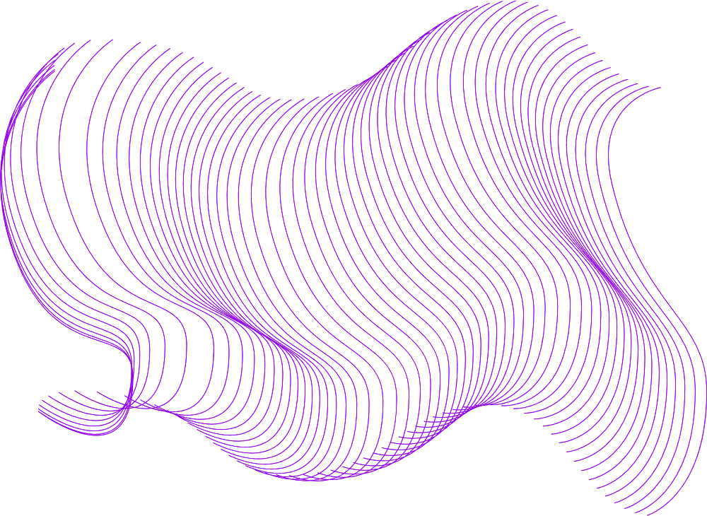
Why LASA Detection is Required in Healthcare:
LASA detection is important in healthcare because medication errors can confuse diagnosis and harm patients.
When the wrong medicine is given, it can change or hide symptoms, making it harder for doctors to understand the real illness.
Some wrong medicines can cause side effects that look like new diseases, which leads to misdiagnosis.
Example: If a patient gets the wrong antibiotic, they may get an allergic reaction. Doctors may think it is a new sickness, not a medicine error.
Many medicine names sound alike or look alike, so nurses can easily mishear or mix them up during fast hospital work.
​
​

Slide 6



Objective:
To prevent Look-Alike Sound-Alike (LASA) medication errors using AI-driven speech and text analysis.
To convert spoken or handwritten medicine names into accurate text using ASR and OCR technologies.
To identify similar-sounding drug names and alert healthcare staff before administration.
To provide correct drug suggestions and safe dosage recommendations in real time.
To build a fast, accessible, and user-friendly tool that supports nurses, pharmacists, and clinicians in improving patient safety.

Slide 7
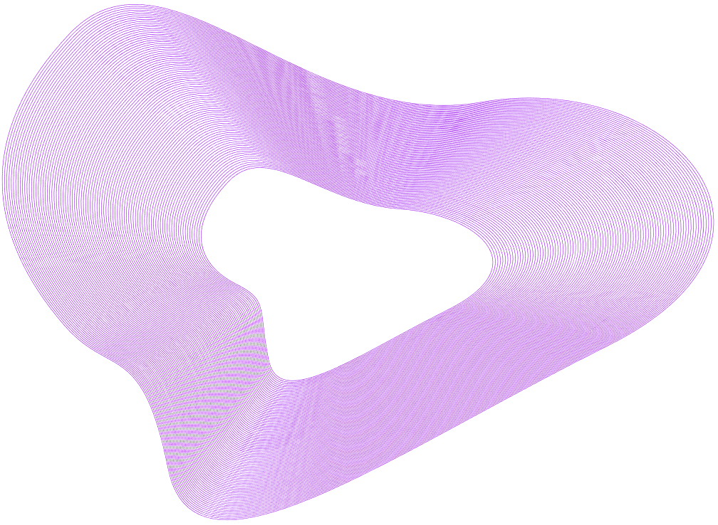
Motivation:
Improve Healthcare Efficiency – Help doctors and pharmacists quickly identify and select the correct medicines.
Enhance Patient Safety – Reduce errors by ensuring the right medication and dosage are prescribed.
Leverage AI & Speech Recognition – Use advanced technologies for real-time, accurate detection of LASA drug names.
Make Healthcare More Accessible – Assist patients and medical staff who face challenges with manual data entry or reading prescriptions.

Slide 8
Existing Research Work:
Automated Speech Recognition (ASR) is a technology that converts spoken language into text.
Uses AI, Machine Learning, and NLP to recognize and process speech.
Helps in voice-based commands, virtual assistants, and transcription services.
Key Research & Advancements:
Popular ASR Systems – Google Speech-to-Text, IBM Watson, Microsoft Azure Speech API.
Challenges in ASR – Accents, background noise, medical terminology recognition, and real-time processing.

Slide 9
Technology Consider :
Frontend
HTML5 – Main user interface
CSS3 – Styling and layout
JavaScript – Handles audio recording & sending text to backend
Backend
Python (Flask) –
Serves UI (GET → index.html)
Processes speech text & OCR text
Core Technologies
ASR (Automatic Speech Recognition)
Converts spoken medicine names to text
Implemented using SpeechRecognition + Google ASR
Algorithms Used
String Similarity (Levenshtein Distance)
Sequence Matching (difflib SequenceMatcher)
Phonetic Similarity (CMU Phonemes + Soundex)
Combined LASA Detection Algorithm
Flags medicine as LASA if similarity ≥ 50%

Slide 10

Future Work:
Real-time LASA Detection:
Detects similar-sounding medicines instantly from speech or prescription images.
User-Friendly Interface:
Develop a dedicated page to display order summaries and tracking details.​
Payment Page:​
Simple, intuitive UI for nurses, doctors, and pharmacists.
Performance and Scalability:​
Optimize database queries

Slide 11
Conclusion:
Enhanced Patient Safety: Reduces medication errors caused by Look-Alike Sound-Alike (LASA) drug confusion.
Real-Time Alerts: Provides instant notifications to nursing staff when a potential LASA error is detected.
AI-Driven Analysis: Uses phonetic analysis and fuzzy matching to identify sound-alike drug names.
Improved Workflow Efficiency: Streamlines medication administration and reduces manual verification efforts.
Supports Clinical Decision-Making: Assists nurses in selecting the correct medication, minimizing risks.

Slide 12

Thank You

